Slide 1
Modern Systems Analysis and Design Sixth Edition Jeffrey A. Hoffer Joey F. George Joseph S. Valacich
Chapter 12
Designing Distributed
and Internet Systems

Slide 2
Learning Objectives
Define
the key terms client/server architecture, local area network LAN, distributed database, and middleware.
Distinguish
between file server and client/server environments and contrast how each is used in a LAN.
Describe
alternative designs for distributed systems and their trade-offs.
Describe
how standards shape the design of Internet-based systems.

Slide 3
Learning Objectives (Cont.)
Describe
how site management issues can influence customer loyalty and trustworthiness as well as system security.
Discuss
issues related to managing online data, including context development, online transaction processing (OLTP), online analytical processing (OLAP), and data warehousing.

Slide 4
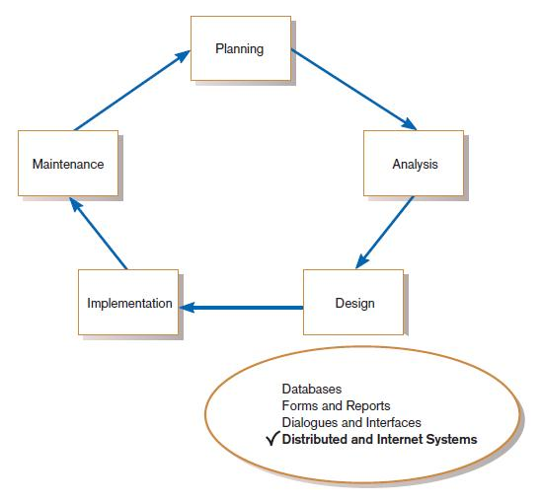
Designing Distributed and Internet Systems
FIGURE 12-1
Systems development life cycle (SDLC)

Slide 5
The Process of Designing Distributed and Internet Systems
Similar to designing single-location systems.
Multi-location deployment, numerous design issues must be considered.
Main issues involve ensuring
reliability, availability, survivability, performance.

Slide 6
Designing Distributed Systems
Distributed systems use:
LAN-based file server architecture.
Client/server architecture.

Slide 7
Designing Systems for Local Area Networks (LANs)
LAN:
the cabling, hardware, and software
Used to connect workstations, computers, and file servers located in a confined geographical area
Typically within one building or campus

Slide 8
File Servers
File server:
A device that manages file operations
Files are shared by each client PC attached to a LAN

Slide 9
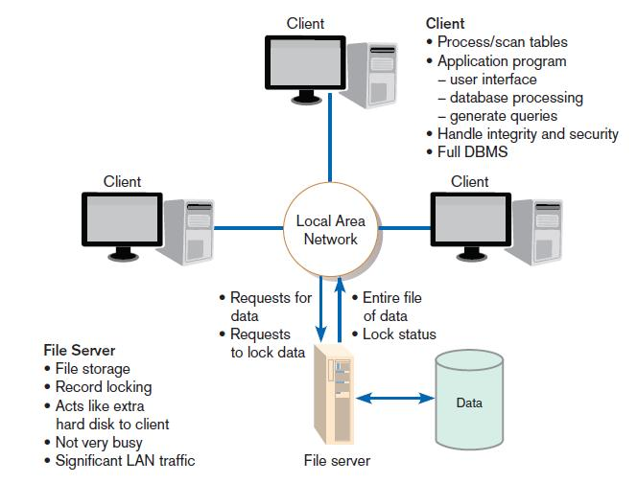
FIGURE 12-3
File server model

Slide 10
Limitations of File Servers
Excessive data movement
Entire data tables must be transferred instead of individual records.
Need for powerful client workstations
Each client workstation must devote memory to a full DBMS.

Slide 11
Designing Systems for a Client/Server Architecture
Client/server architecture:
LAN-based computing environment
Central database server or engine performs all database commands sent to it from client workstations
Application programs on each client concentrate on user interface functions

Slide 12
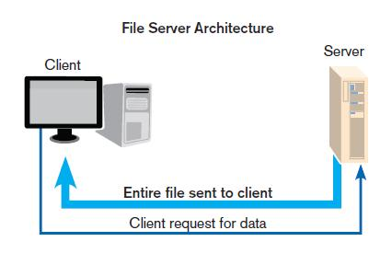
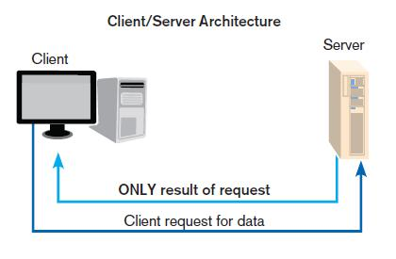
File Server vs. Client/Server

Slide 13
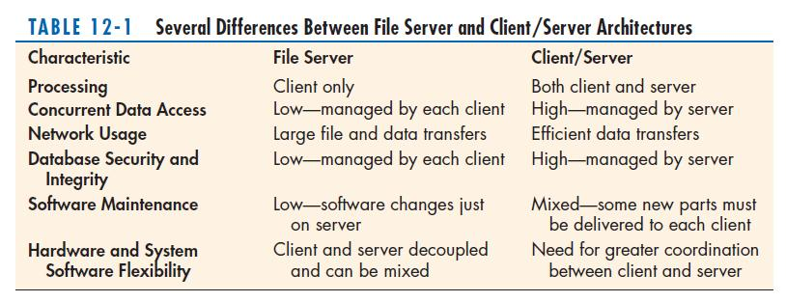
File Server vs. Client/Server (cont.)

Slide 14
Designing Systems for a Client/Server Architecture
Application processing is divided between client and server.
Client manages the user interface.
Database server is responsible for data storage and query processing.

Slide 15
Designing Systems for a Client/Server Architecture (Cont.)
Database engine:
the (back-end) portion of the client/server database system running on the server
Provides database processing and shared access functions

Slide 16
Designing Systems for a Client/Server Architecture (Cont.)
Client:
The (front-end) portion of the client/server database system
Provides the user interface and data manipulation functions

Slide 17
Designing Systems for a Client/Server Architecture (Cont.)
Application program interface (API):
Software building blocks that are used to ensure that common system capabilities, such as user interfaces and printing, as well as modules are standardized to facilitate data exchange between clients and servers
Common API interface can be used by any kind of DBMS (MySQL, Sybase, or Oracle)

Slide 18
Client/Server Advantages and Cautions
Advantages
Leverages benefits of microcomputer technology
Processing performed close to data source
Improves response time
Reduces network traffic
Facilitates use of GUIs
Encourages acceptance of open systems

Slide 19
Client/Server Advantages and Cautions
Cautions
Difficult migration from file server to client/server
Compatibility issues
Limited system design and performance monitoring tools

Slide 20
Advanced Forms of Client/Server Architectures
Three general components:
Data Management: manages all interaction between software and database; such as: data retrieving, querying, updating, security.
Data Presentation: manages the interface between system users and software; such as display forms and print reports.
Data Analysis: transforms inputs to output.

Slide 21
Advanced Forms of Client/Server Architectures
Application server:
A computing server where data analysis functions primarily reside
Three-tiered client/server:
Advanced client/server architectures in which there are three logical and distinct applications
Data management, presentation, and analysis – that are combined to create a single information system

Slide 22
Advanced Forms of Client/Server Architectures (Cont.)
Middleware:
A combination of hardware, software, and communication technologies
Bring data management, presentation, and analysis together into a three-tiered client/server environment.

Slide 23
Designing Internet Systems
Most new system development focuses on Internet-base applications
for internal processing, business-to-business, and business-to-consumer.
Main design issues:
standards, separating content from display, future evolution, site consistency, site management and online data management

Slide 24
Standards Drive the Internet
Types of Standards:
Domain naming: a method for translating domain names into Internet Protocol (IP) addresses
“Hypertext Transfer Protocol (HTTP): a communication protocol for exchanging information on the Internet
Hypertext Markup Language (HTML): the standard language for representing content on the Web via command tags

Slide 25
Future Evolution
Thin client: a client device designed so that most processing and data storage occur on the server
Use of wireless mobile devices
Wireless Access Protocol (WAP): a wireless version of HTTP
Wireless Markup Language (WML): a wireless version of HTML

Slide 26
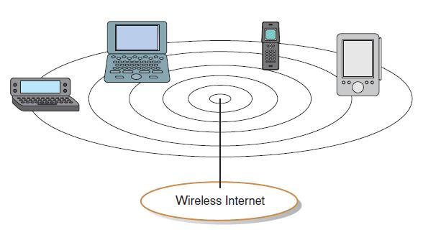
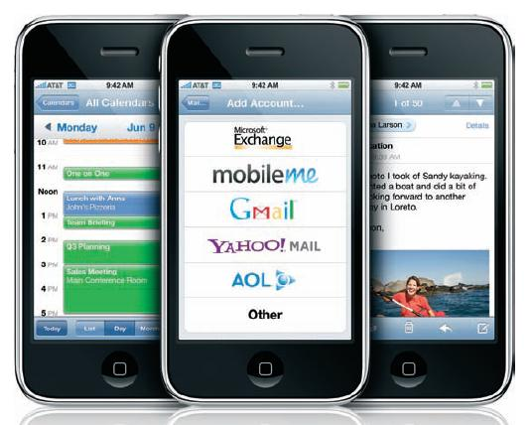
FIGURE 12-8
Thin clients used to access the Internet
FIGURE 12-9
Thin clients typically have a limited
screen size

Slide 27
Customer Loyalty and Trustworthiness
Personalization:
Providing Internet content to a user based upon knowledge of that customer
Customization:
Internet sites that allow users to customize the content and look of the site based on their personal preferences

Slide 28
Online Transaction Processing (OLTP)
Online transaction processing (OLTP): the immediate automated responses to the requests of users
Designed to handle multiple concurrent transactions.
Plays a large role in electronic commerce applications.

Slide 29
Online Analytical Processing (OLAP)
Online analytical processing (OLAP): the use of graphical software tools that provide complex analysis of data stored in a database
OLAP server is the chief component.
Good for time series and trend analysis.
Enables user to “drill-down” into the data.

Slide 30
Data Warehousing
Data warehouse:
a subject-oriented, integrated, time-variant, and nonvolatile collection of data used in support of management decision making

Slide 31
Data Warehousing (Cont.)
Key features
Subject-oriented: organized around key subjects
Integrated: data are collected from many operational systems and made to conform to standards
Time-variant: data contains a time dimension
Nonvolatile: data cannot be updated by users

Slide 32
Data Warehousing (Cont.)
Four basic building steps:
Extract data from various source system files and databases.
Transform, integrate, and load the data.
Data warehouse is a read-only environment.
Users access via query languages and analytical tools.

Slide 33
Data Warehousing (Cont.)
Two level Architecture:
Data warehouse and decision support environment
Three-level architecture:
Operational systems and data
An enterprise data warehouse
Data marts

Slide 34
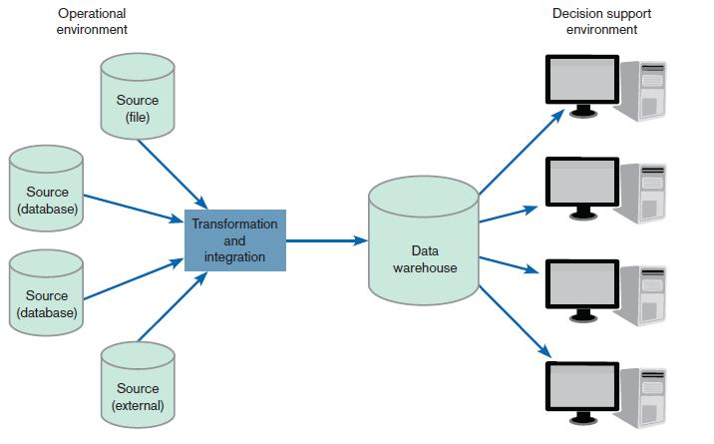
FIGURE 12-18
Generic two-tier data
warehouse architecture

Slide 35
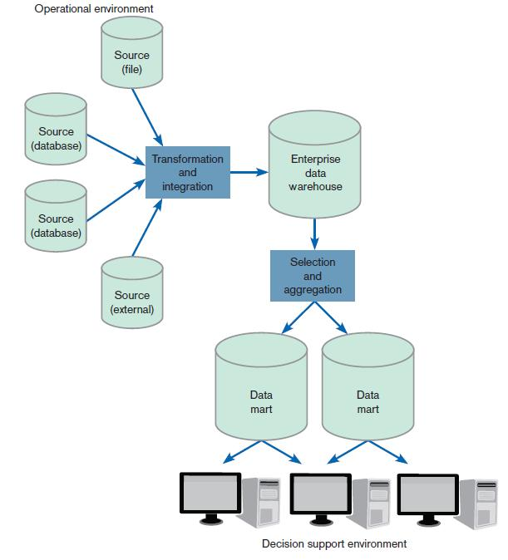
FIGURE 12-19
Three-tier warehouse architecture

Slide 36
Data Warehousing (Cont.)
Enterprise data warehouse (EDW): a centralized, integrated data warehouse that is the control point and single source of all data made available to end users
for decision support applications throughout the entire organization
Data mart: a data warehouse that is limited in scope; its data are obtained by selecting and (where appropriate)
summarizing data from the enterprise data warehouse

Slide 37
Web Site Content Management
Content management system (CMS): a special type of software application for collecting, organizing, and publishing Web site content

Slide 38
Thanks

